Slide 1
Euclidean Algorithm
Dr.N.Gopika Rani,
Assistant Professor (SG),
Department of CSE

Slide 2
Greatest Common Divisors
The greatest common divisor of two positive integers is the largest integer that can divide both integers.
Euclidean Algorithm
Fact 1: gcd (a, 0) = a
Fact 2: gcd (a, b) = gcd (b, r), where r is the remainder of dividing a by b

Slide 3
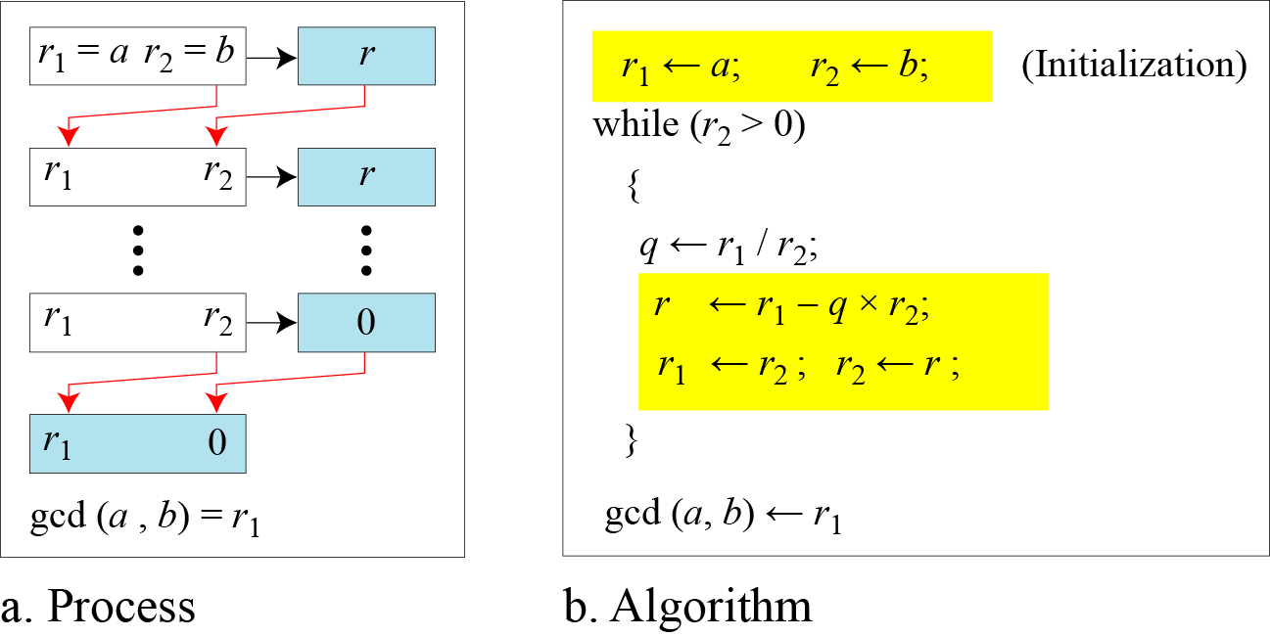
Euclidean Algorithm
When gcd (a, b) = 1, we say that a and b are relatively prime.

Slide 4
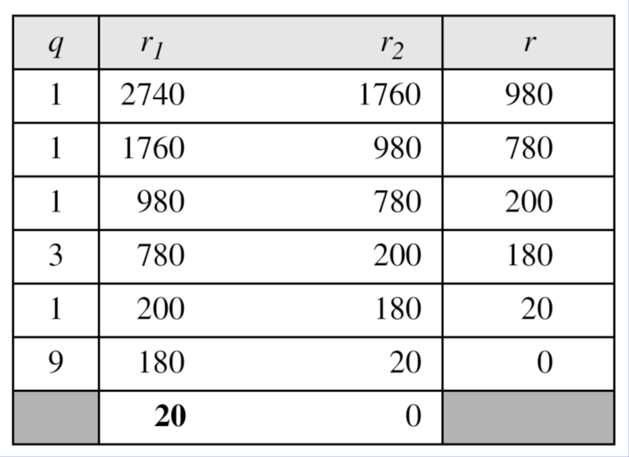
Find the greatest common divisor of 2740 and 1760.
Solution
gcd (2740, 1760) = 20.

Slide 5
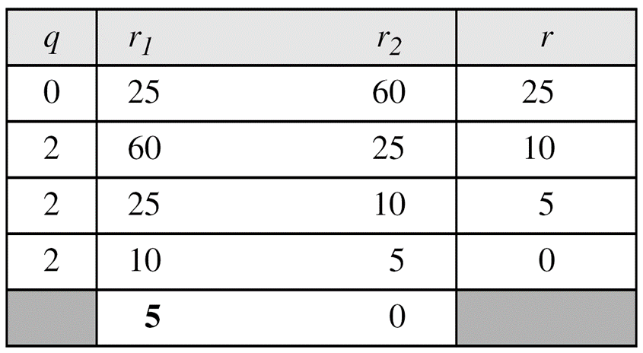
Find the greatest common divisor of 25 and 60.
Solution
gcd (25, 65) = 5

Slide 6

Multiplicative Inverse
In Z_{n}, two numbers a and b are the multiplicative inverse of each other if
In modular arithmetic, an integer may or may not have a multiplicative inverse.
When it does, the product of the integer and its multiplicative inverse is congruent to 1 modulo n.

Slide 7
Extended Euclidean algorithm
The extended Euclidean algorithm finds the multiplicative inverses of b in Z_{n} when n and b are given and gcd (n, b) = 1.
The multiplicative inverse of b is the value of t after being mapped to Z_{n}.

Slide 8
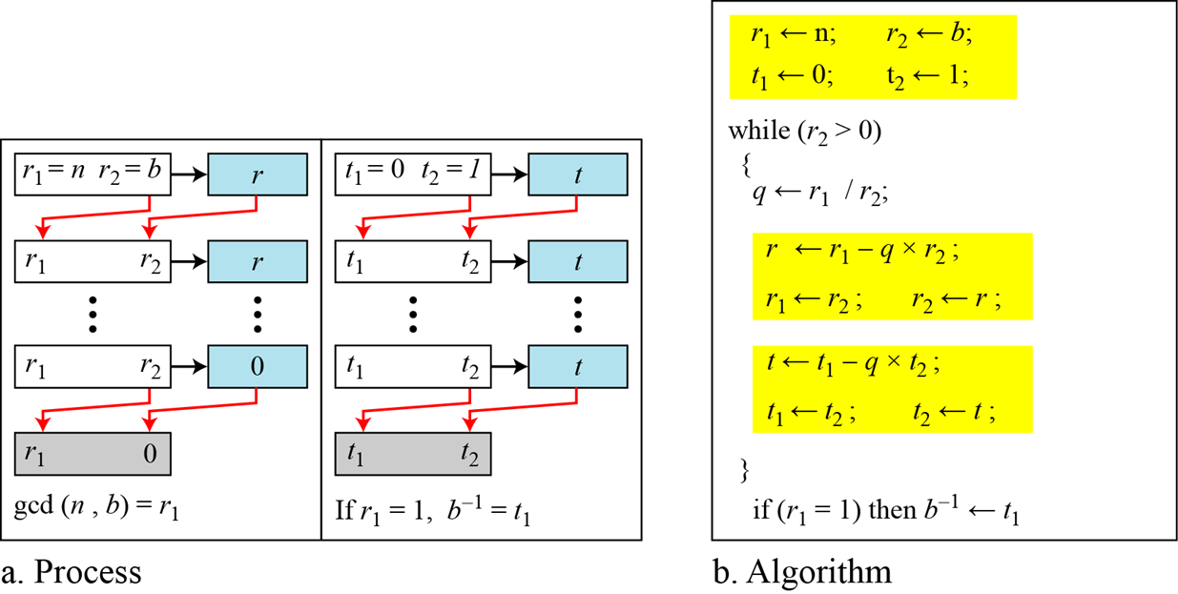

Slide 9
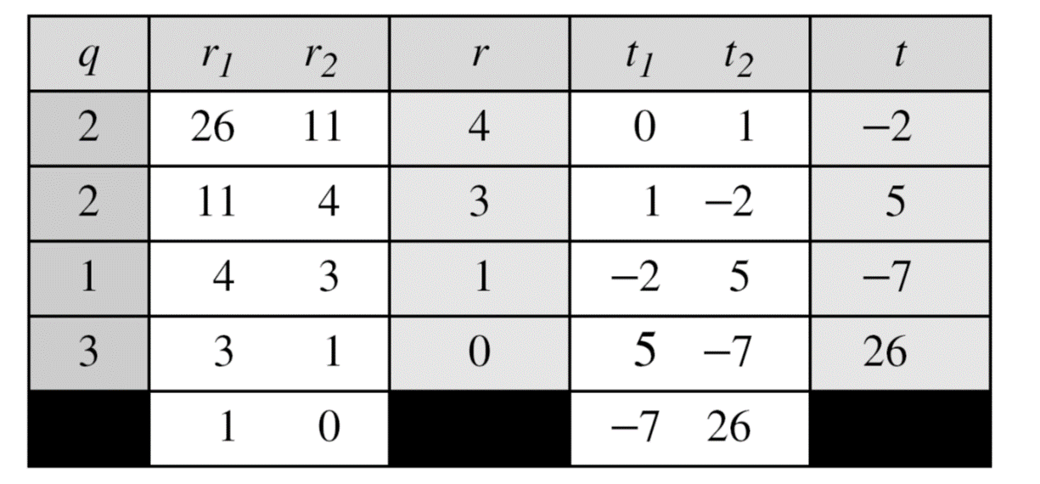
Find the multiplicative inverse of 11 in Z₂₆.
Solution
The gcd (26, 11) is 1; the inverse of 11 is −7 or 19.

Slide 10
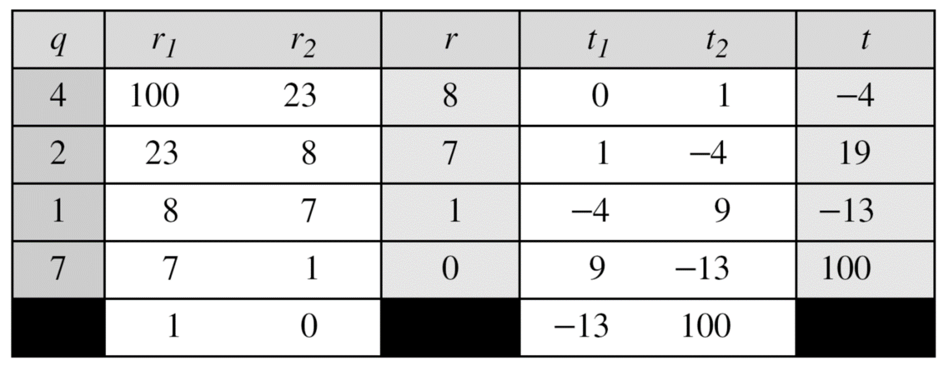
Find the multiplicative inverse of 23 in Z₁₀₀.
Solution:
The gcd (100, 23) is 1; the inverse of 23 is −13 or 87.

Slide 11
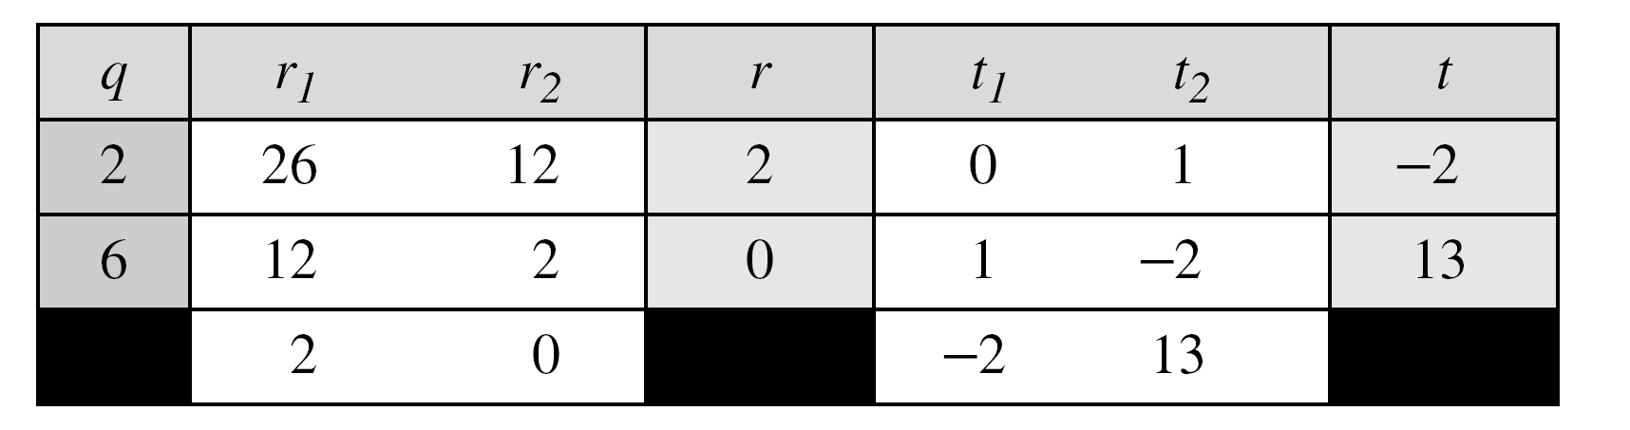
Find the inverse of 12 in Z₂₆.
Solution:
The gcd (26, 12) is 2; the inverse does not exist.

